Slide 1
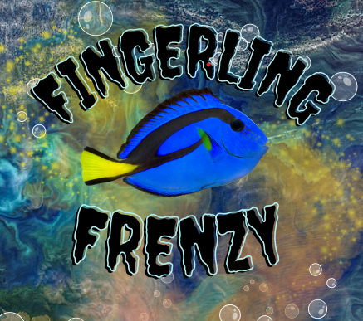
Brought to you by: TRINE UNIVERSITY

Slide 2
Fingerling Frenzy A Coral Triangle Card Game
"Fingerling Frenzy" is an immersive educational game that transports players into the biodiverse but threatened ecosystem of the Coral Triangle.
This two-player game consists of a deck of cards of specific fish along with a computer-based scoring system.
In each round, the number of fish a player has is determined by the location on a map and fish characteristics including tolerance to pollution, size, and eating habits.
The first player to have a school of 100 fish wins.

Slide 3
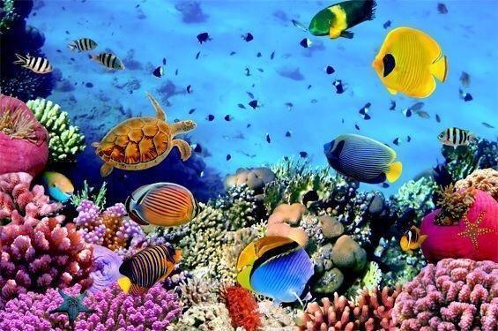
Motivation
Coral reefs contain over 800 different species and a quarter of all ocean animals.

Slide 4
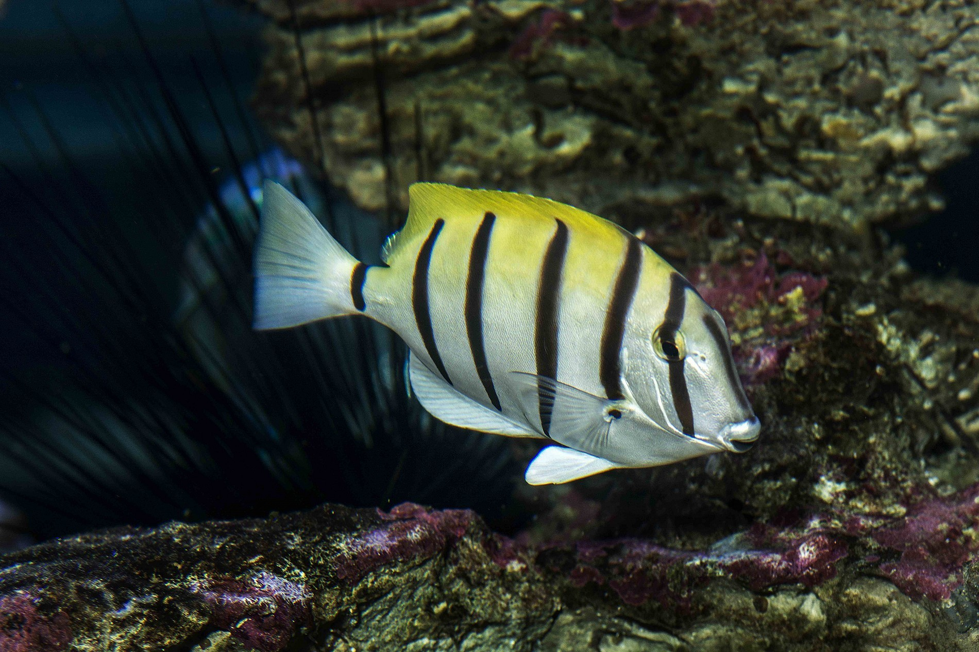
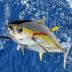
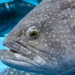
Motivation 2
These animals are an important part of our ecosystem that keeps the planet and its inhabitants alive.

Slide 5
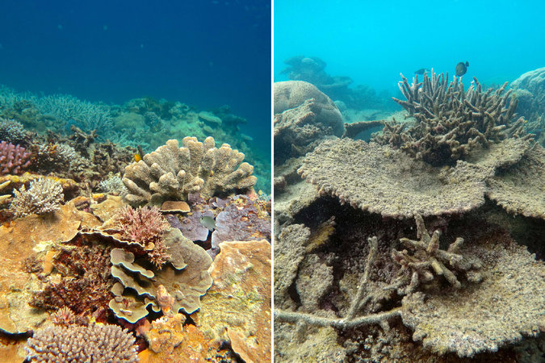
Motivation
From 2009-2018, 14% of coral reef habitats were lost on this planet.

Slide 6
Second Slide Master
Use our amazing, awesome pre-made presentation design templates to transform your boring, sleep-inducing presentation into an aggressive, professional, energetic, jaw-dropping presentation in nearly no time at all.
The PowerPoint Templates (ppt) our creative graphics designers have developed are masterfully thought out, with superior backgrounds, awesome graphics, and text formatting.
Our design templates have been specifically optimized for use in Microsoft PowerPoint, making them easy-to-use for even a novice user.

Slide 7
Second Slide Master
Use our amazing, awesome pre-made presentation design templates to transform your boring, sleep-inducing presentation into an aggressive, professional, energetic, jaw-dropping presentation in nearly no time at all.
The PowerPoint Templates (ppt) our creative graphics designers have developed are masterfully thought out, with superior backgrounds, awesome graphics, and text formatting.
Our design templates have been specifically optimized for use in Microsoft PowerPoint, making them easy-to-use for even a novice user.

Slide 8
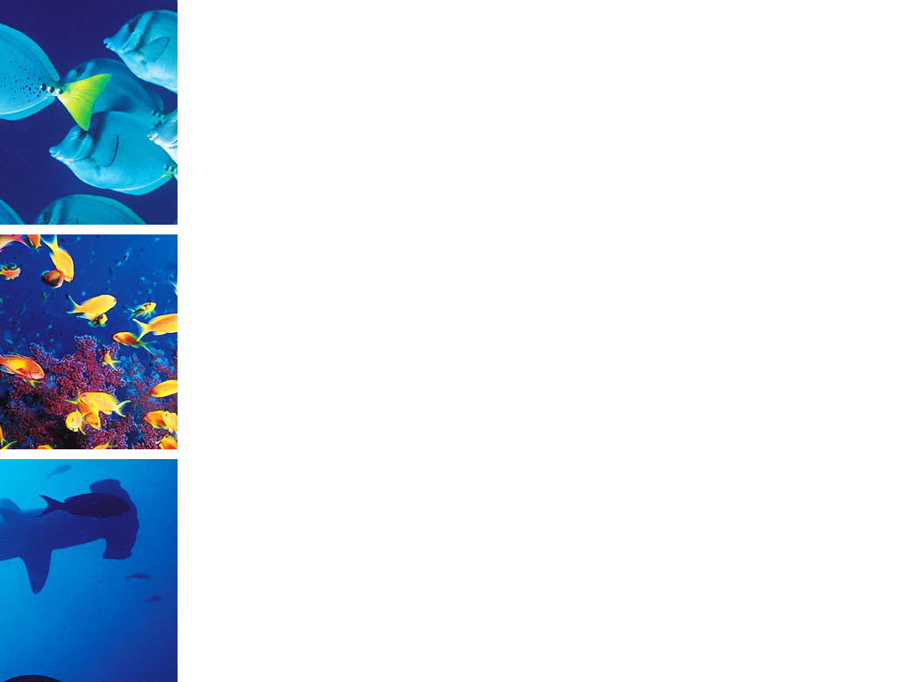
Print Slide Master
Our PowerPoint templates and backgrounds are «pre-made» presentation shells («pre-made» slides). All design backgrounds, graphics, typefaces, and colors have been created and are pre-set by an expert graphic designers which are working with some of the most prominent businesses in the world.
You simply insert your text. That's it! You just can't go wrong with these templates and backgrounds!
Download this template as well as our others at http://poweredtemplate.com/nature-ppt-powerpoint-templates.html

Slide 9
Print Slide Master
Our PowerPoint templates and backgrounds are «pre-made» presentation shells («pre-made» slides). All design backgrounds, graphics, typefaces, and colors have been created and are pre-set by an expert graphic designers which are working with some of the most prominent businesses in the world.
You simply insert your text. That's it! You just can't go wrong with these templates and backgrounds!
Download this template as well as our others at http://poweredtemplate.com/nature-ppt-powerpoint-templates.html

Slide 10
Print Slide Master
Our PowerPoint templates and backgrounds are «pre-made» presentation shells («pre-made» slides). All design backgrounds, graphics, typefaces, and colors have been created and are pre-set by an expert graphic designers which are working with some of the most prominent businesses in the world.
You simply insert your text. That's it! You just can't go wrong with these templates and backgrounds!
Download this template as well as our others at http://poweredtemplate.com/nature-ppt-powerpoint-templates.html

